Slide 1
Inner Classes

Slide 2
Agenda
Java Inner classes
Advantage of Inner class
Difference between nested class and inner class
Types of Nested classes

Slide 3
Inner class
Java inner class or nested class is a class i.e. declared inside the class or interface.
We use inner classes to logically group classes and interfaces in one place so that it can be more readable and maintainable.
Additionally, it can access all the members of outer class including private data members and methods.

Slide 4
Syntax of inner class
class Java_Outer_class{
//code
class Java_Inner_class{
//code
}
}

Slide 5
Advantage of java inner classes
1) Nested classes represent a special type of relationship that is it can access all the members (data members and methods) of outer class including private.
2) Nested classes are used to develop more readable and maintainable code because it logically group classes and interfaces in one place only.
3) Code Optimization: It requires less code to write.

Slide 6
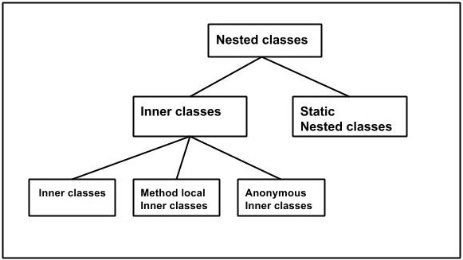
Types of Nested classes

Slide 7
Difference between nested class and inner class in Java
Inner class is a part of nested class.
Non-static nested classes are known as inner classes.

Slide 8
Types of Nested classes
Non-static nested class(inner class)
a)Member inner class
b)Annonymous inner class
c)Local inner class
Static nested class

Slide 9
Type | Description
Member Inner Class | A class created within class and outside method.
Anonymous Inner Class | A class created for implementing interface or extending class. Its name is decided by the java compiler.
Local Inner Class | A class created within method.
Static Nested Class | A static class created within class.
Nested Interface | An interface created within class or interface.

Slide 10
Member inner class
A non-static class that is created inside a class but outside a method is called member inner class.
Syntax
class Outer{
//code
class Inner{
//code
}
}

Slide 11
class Outer {
private int data = 50;
class Inner {
void print() {
System.out.println("data: " + data);
}
}
public static void main(String[] args) {
Outer outer = new Outer();
Outer.Inner inner =outer.new Inner();
inner.print();
}
}

Slide 12
Internal working of Java member inner class
The java compiler creates two class files in case of inner class. The class file name of inner class is "Outer$Inner".
If you want to instantiate inner class, you must have to create the instance of outer class. In such case, instance of inner class is created inside the instance of outer class.

Slide 13
Anonymous inner class
A class that have no name is known as anonymous inner class in java. It should be used if you have to override method of class or interface.
Java Anonymous inner class can be created by two ways:
1. Class (may be abstract or concrete).
2. Interface

Slide 14
Java anonymous inner class example using class
abstract class Person{
abstract void eat();
}
class TestAnonymousInner{
public static void main(String args[]){
Person p=new Person(){
void eat(){System.out.println("nice fruits");}
};
p.eat();
}
}

Slide 15
Java anonymous inner class example using class
interface Eatable{
void eat();
}
class TestAnnonymousInner1{
public static void main(String args[]){
Eatable e=new Eatable(){
public void eat(){System.out.println("nice fruits");}
};
e.eat();
}
}

Slide 16
Method local inner class
A class i.e. created inside a method is called local inner class in java. If you want to invoke the methods of local inner class, you must instantiate this class inside the method.

Slide 17
public class Outer {
private int data = 50;
void display(){
int value=50;//local variable must be final till jdk 1.7 only
class LocalInner{
void msg(){
System.out.println(data);
System.out.println(value);
}
}
LocalInner local = new LocalInner();
local.msg();
}
public static void main(String[] args) {
Outer o = new Outer();
o.display();
}
}

Slide 18
Rules for Local Inner class
Local inner class cannot be invoked from outside the method
Local inner class cannot access non-final local variable till JDK 1.7. Since JDK 1.8, it is possible to access the non-final local variable in local inner class.

Slide 19
static nested class
A static class i.e. created inside a class is called static nested class in java.
It cannot access non-static data members and methods. It can be accessed by outer class name.
It can access static data members of outer class including private.
Static nested class cannot access non-static (instance) data member or method.

Slide 20
static nested class example with instance method
class TestOuter{
static int data=30;
static class Inner{
void msg(){System.out.println("data is "+data);}
}
public static void main(String args[]){
TestOuter.Inner obj=new TestOuter.Inner();
obj.msg();
}
}

Slide 21
Observation
In this example, you need to create the instance of static nested class because it has instance method msg(). But you don't need to create the object of Outer class because nested class is static and static properties, methods or classes can be accessed without object.

Slide 22
static nested class example with static method If you have the static member inside static nested class, you don't need to create instance of static nested class.
class TestOuter{
static int data=30;
static class Inner{ //static method
static void msg(){System.out.println("data is "+data);}
}
public static void main(String args[]){
TestOuter2.Inner.msg();//no need to create the instance of static nested class
}
}

